Slide 1




UNNAMED PROJECT
LUYOLO MBATHA
&
NHLANHLA LANGA
PT.2

Slide 2
CRIT 1
RECAP
Notes:
Overview

Slide 3
Project Recap
01
Customization
02
Music Player
Customise :
Indoor/Outdoor environments
Characters(hair, eye colour etc.)
Log-in to your Spotify/Youtube music
Control the music player
Enjoy Lofi Music as you study
03
Self-study
04
Watch your character
Set a timer, mood and study away
Complete a to-do list, keep yourself on schedule!
Get motivational quotes!
Set a reminder for small breaks
Your character sits on the chair when you're studying
The character jumps up and down when exercising
The player Idles when they have nothing to do

Slide 4
Current Standing?
01
Customization
02
Music Player
Indoor Enviroment:
Change bedroom wallpaper.
Color adjustment of in app furniture.
Light adjustment: colour and intensity
Log-in to your Spotify/Youtube music
Offline music player
03
Self-study
04
Watch your character
Set a timer, mood and study away
Complete a to-do list, keep yourself on schedule!
Save The to-list and be able to retrieve the data they had put in a different session
Your character can move to positions on in the environment
We created systems it will need to sit down when instructed as we faced a particular challenge

Slide 5


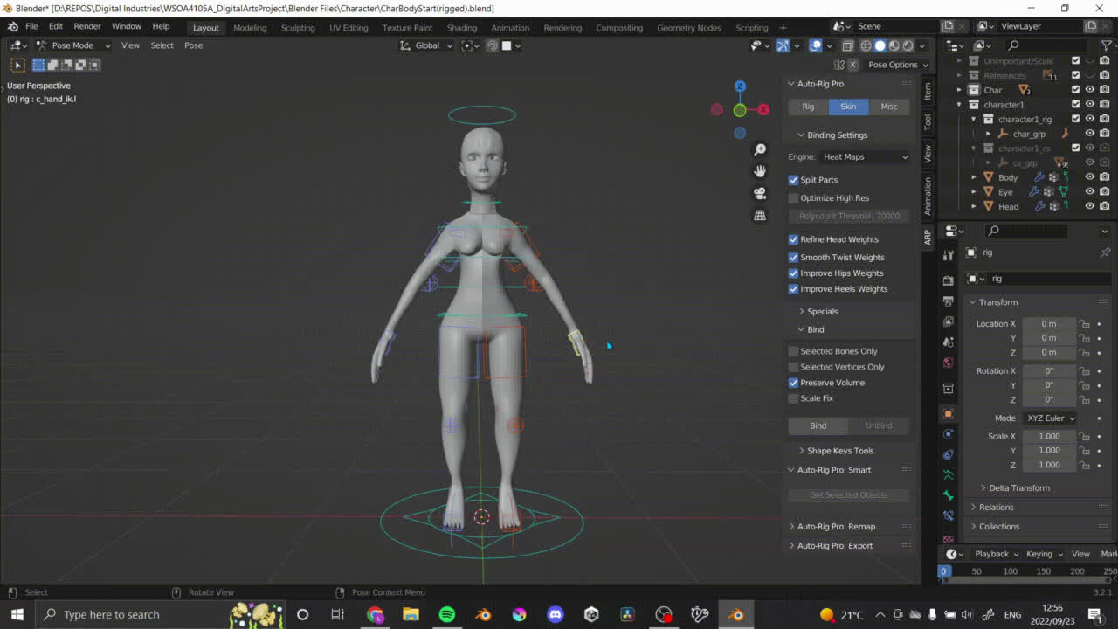
Challenges
Current
Creation of character.
Sculpting & Rigging.
Character customisation.
Removal of outdoor environment.
Untimely power cuts.
Previous
Spotify setup
Finding scheduling programs
To-do List Dependency & Player NPC AI
Notes:
Virtual cottage
Poly

Slide 6
Timeline
25th July - 18th November
The project length is 17 weeks long , 5 phases
Phase 1 - Project Setup
Phase 2 - System Implementation
Phase 3- Larger customisation & playtesting
Phase 4 - Agile methodogolgy(Implement, playtest, curate )
Phase 5 - Polishing
Notes:
Virtual cottage
Poly

Slide 7
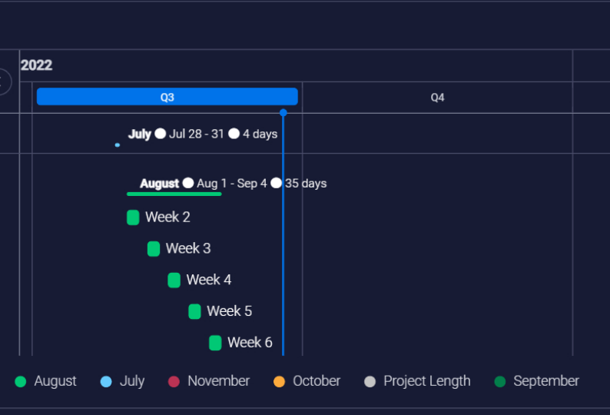
Timeline - Phase 1
Phase 1 - Set Up
28 July - 14 August (weeks 1-3)
Creation and Implementation of objects influenced by systems.
Texture baking for object sets.
Notes:
Virtual cottage
Poly

Slide 8
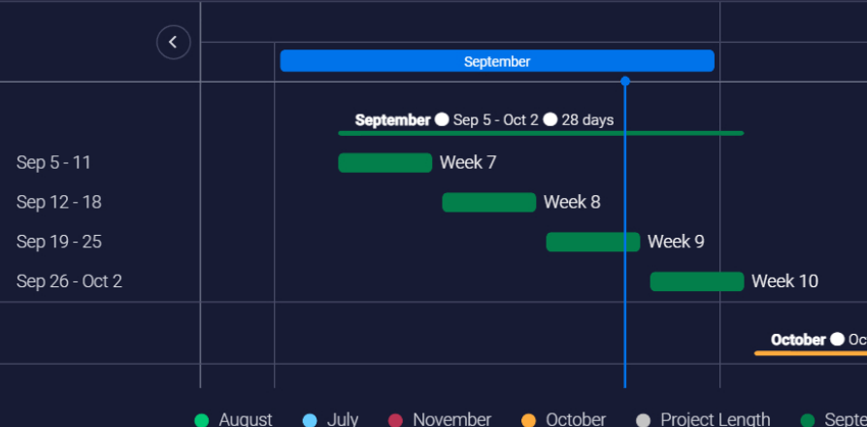
Timeline - Phase 2
Phase 2 - System Implementation
15th August - 2nd October(Weeks 4 - 10)
Implementation of logic for the application's mechanics.
To-do list & Timer
Spotify media player & Ofline music player
Customisation of furniture: Colour and pattern change
Light customisation : Colour and intensity.
Notes:
Virtual cottage
Poly

Slide 9
Timeline - Phase 2
Phase 2 - System Customisation
15th August - 2nd October(Weeks 4 - 10)
Customisation :
Character's facial features
Switching out of in-app objects.
Beginning of Playtesting(last week)
Notes:
Virtual cottage
Poly

Slide 10
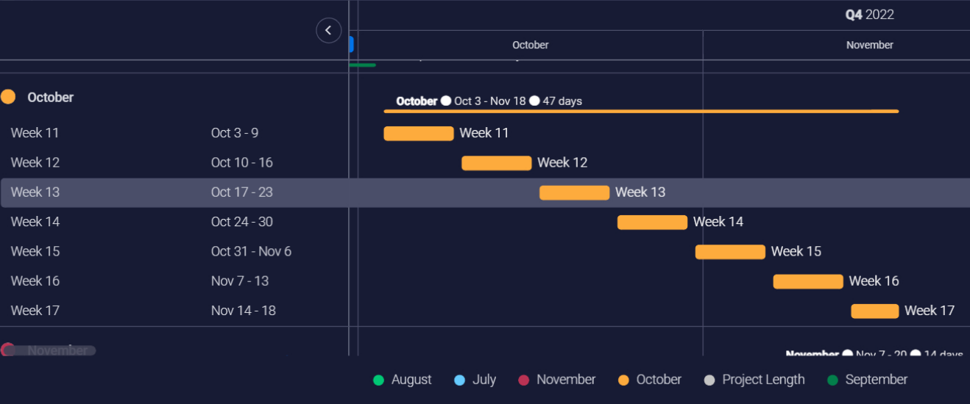
Timeline - Phase 3
Phase 3 - Larger customisation system & UI
3rd October - 23 October (weeks 11-13)
Further implementation of phase 1 objects
Rotational objects.
UI
4-6 Playtest sessions per week
Notes:
Virtual cottage
Poly

Slide 11
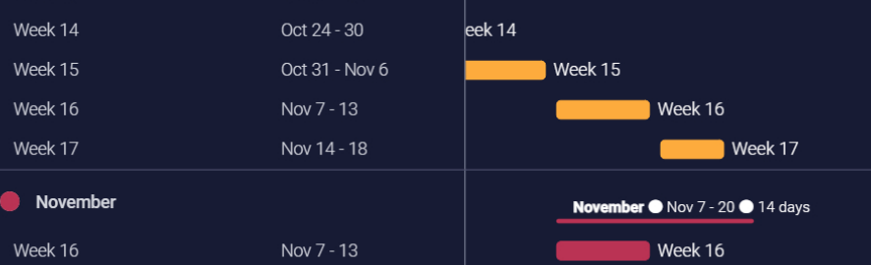
Timeline - Phase 4
Phase 4 - Playtesting
24th October - 6th November (weeks 14 - 15 )
4 - 6 playtesting session per week
Notes:
Virtual cottage
Poly

Slide 12
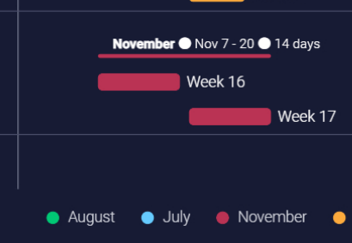
Timeline - Phase 5
Phase 5 - Polishing & Finalisation
7th November - 18 November(weeks 16- 17)
Final polishing of in - app mechanics.
Final round of playetsting(future iterations).
Notes:
Virtual cottage
Poly

Slide 13
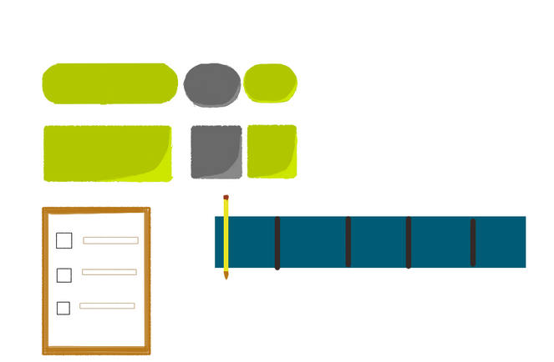
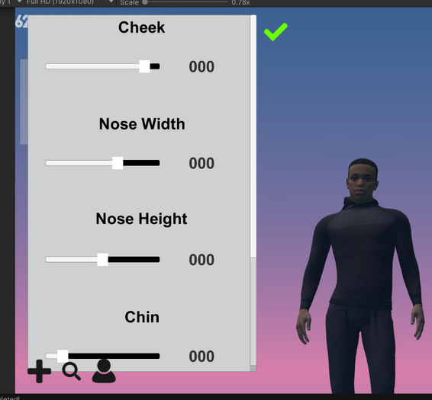

Upcoming Iterations/Intentions
These number are all estimations. We may work more or less than what is prescribed
User Interface
Introduction of organised custom made interface
Character
Character customisation(hair and clothing )
Character animations according to activity
Playtesting
Weekly play tests(averaging 4 to 6 tests weekly)
Daily Expectations
4.5 hrs+

Slide 14


NHLANHLA
LEAD CHARACTER MODEL
Designing Base Model For Character
Design Systems in Unity
Career Aspirations
Generalist
Lead Programmer
Character Designer

Slide 15

LUYOLO
LEAD ASSET DEVELOPER
Art Direction.
Creating 3D assets final iteration .
Importing visual assets to game engine.
Career Aspirations
3D artist - modelling , animator.
3D Printing

Slide 16
Project
Feel good study application?
Easy To Use Options?
Readable UI?
GOAL
REFLECTION
Personal
Developing Skillset - sculpting, Asset optimisation etc.?
Industry preparing portfolio project?

Slide 17
THANKS
FOR LISTENING AND ENJOY THE GAMEPLAY

Slide 18
REFERENCES
https://www.instagram.com/polygonrunway/
https://store.steampowered.com/app/1369320/Virtual_Cottage/
https://www.artstation.com/artwork/D5NNlO
www.reallygreatsite.com

